Slide 1
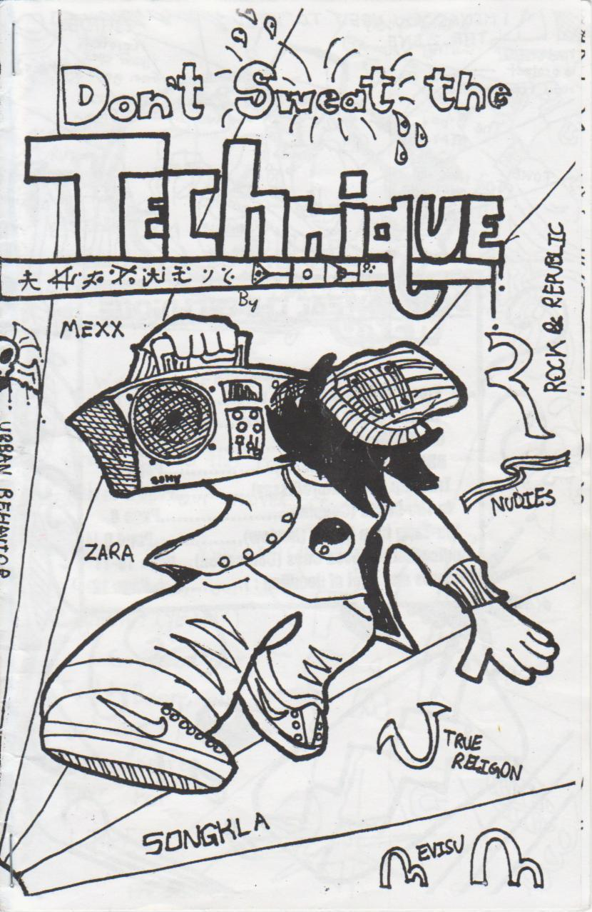

ZINES!
Students as writers, editors and publishers in junior high English language arts

Slide 2
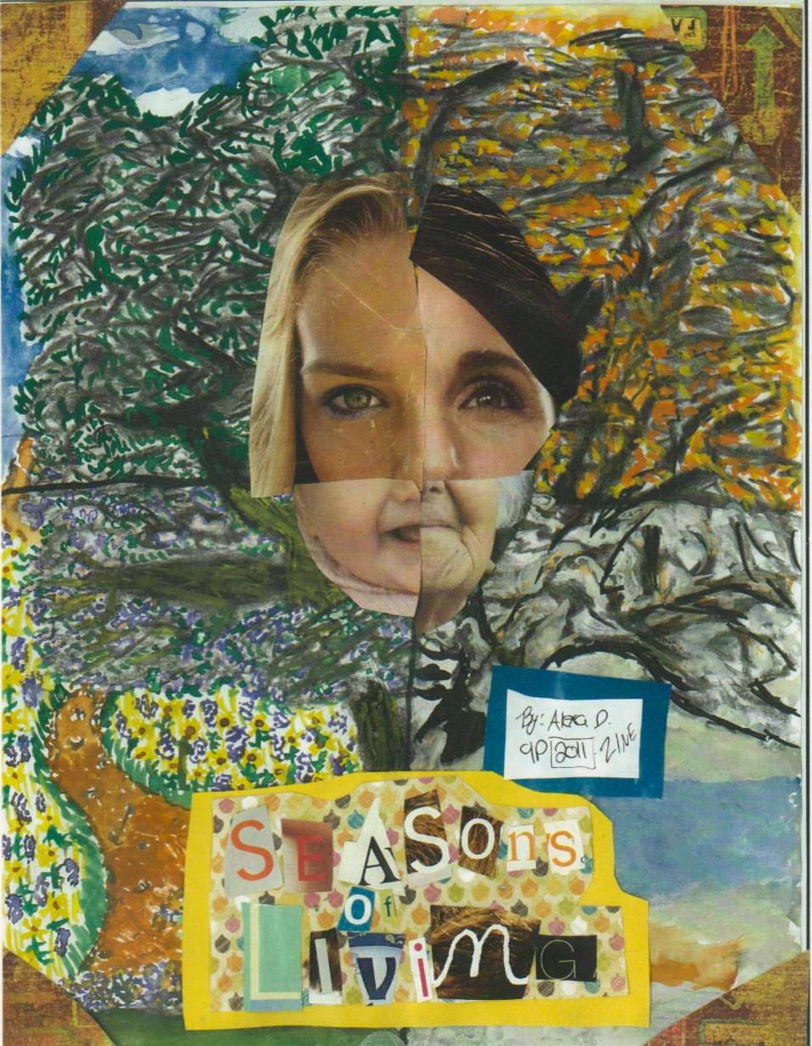

session outline
Background
Definition
Benefits
The grade 9 zine unit plan
20 minute zine
Other ways to publish
Questions
Prizes!

Slide 3

Background
Nancie Atwell (In the Middle)
What do writers (and students) need?
  Time
  Freedom
  Audience
  One-to one support

Slide 4
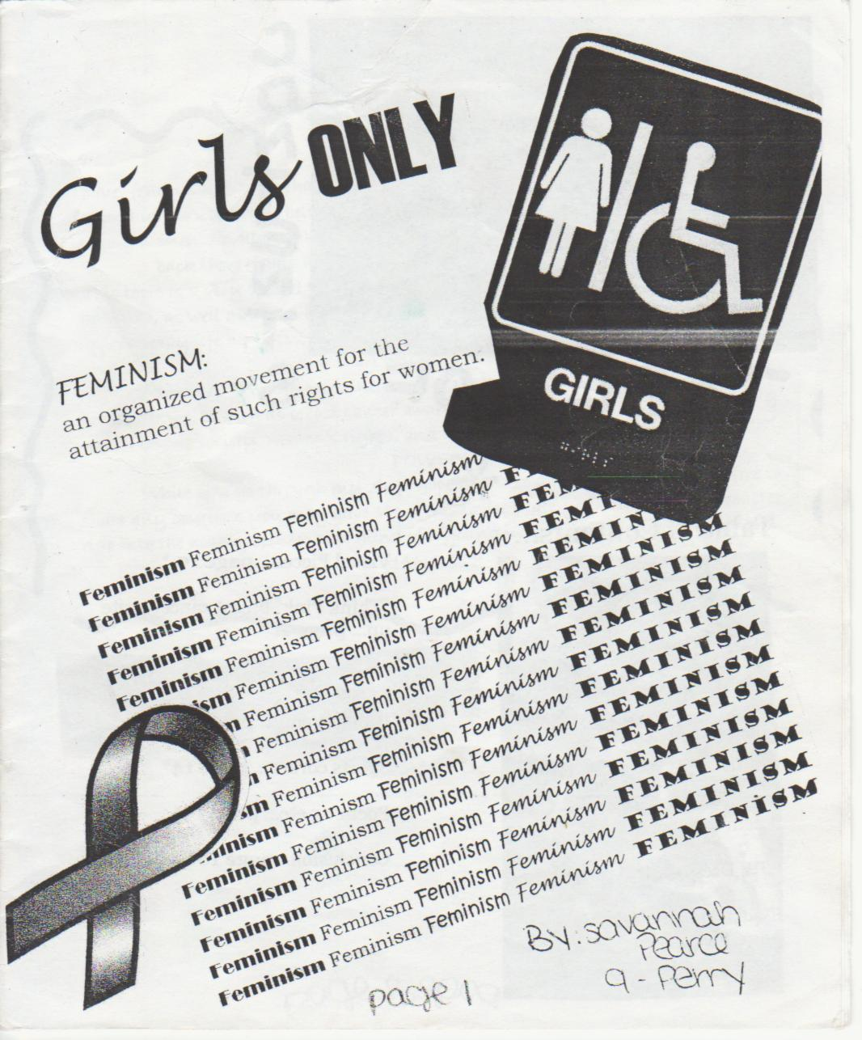
What is a zine?
Independent “magazine”
Cheap
On any subject or theme
Usually photocopied in B&W
Variety of formats
Small circulation

Slide 5
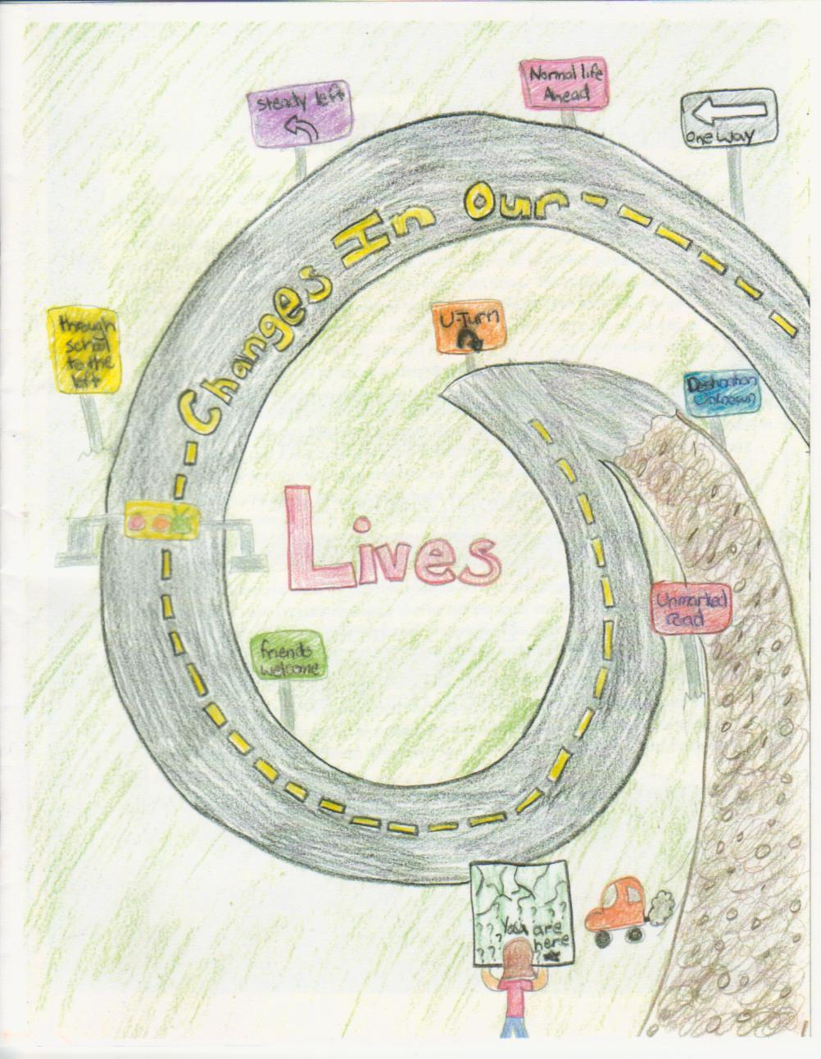
Benefits
Differentiated learning
Authentic audience
“Covers” the Program of Study
Uses all six language arts (Reading, Writing, Listening, Speaking, Viewing, Representing)
Wide variety of genres, including, but not limited to…

Slide 6
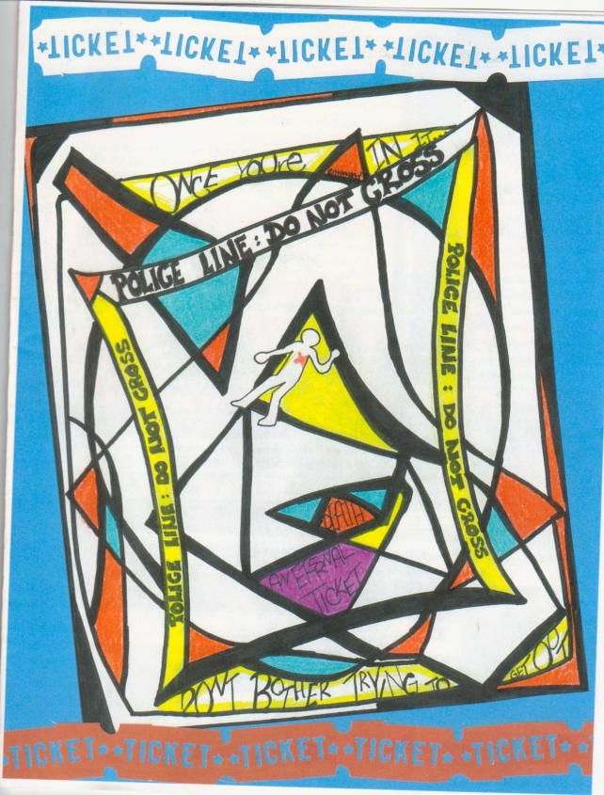


Business letters
Essays
Fiction
Poetry
Visual art
Interviews
And more…

Slide 7
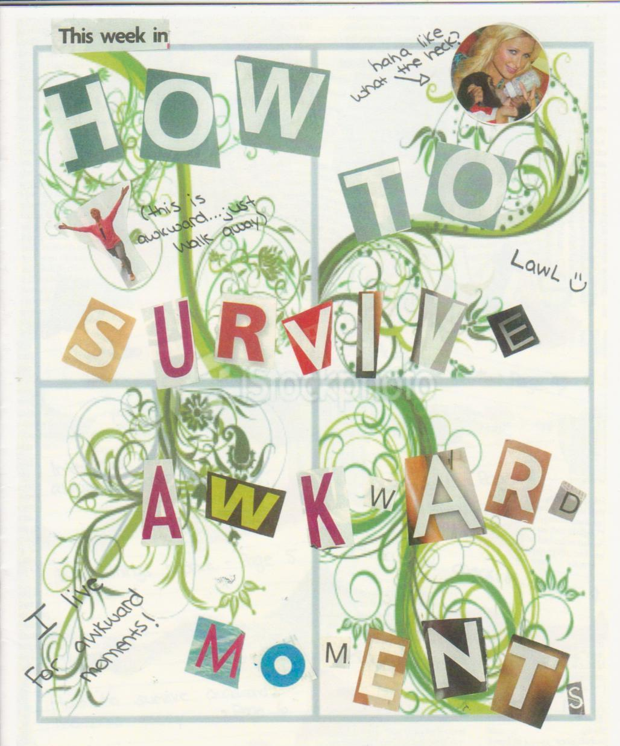
Grade 9 Unit Plan
Teacher Preparation
Learn how to make a zine
Get to know your photocopier
Calendar of important dates
Know your minimum requirements
Gather materials

Slide 8
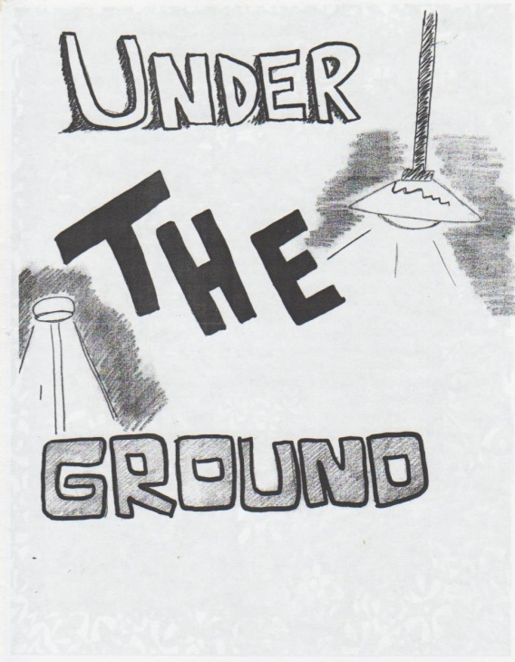
First class - Intro
Give background on zines
  Websites
  Exemplar zines from previous years
  Brainstorm answers to “What is a zine?” and “What makes a good zine?”

Slide 9
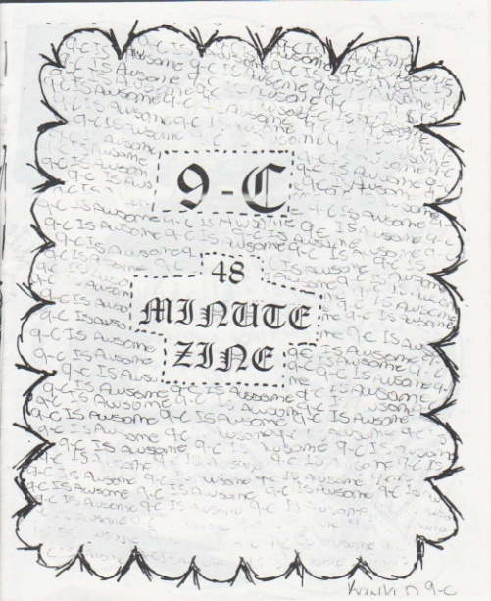
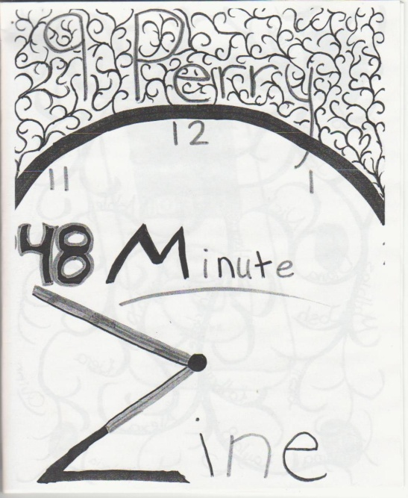
Second class – 48 Minute ZIne
Give students a one day heads up
Have materials ready:
  One piece of blank paper per student
  Sharpie markers, pens, pencils
  Magazines
  Glue
  Scissors
  Other

Slide 10

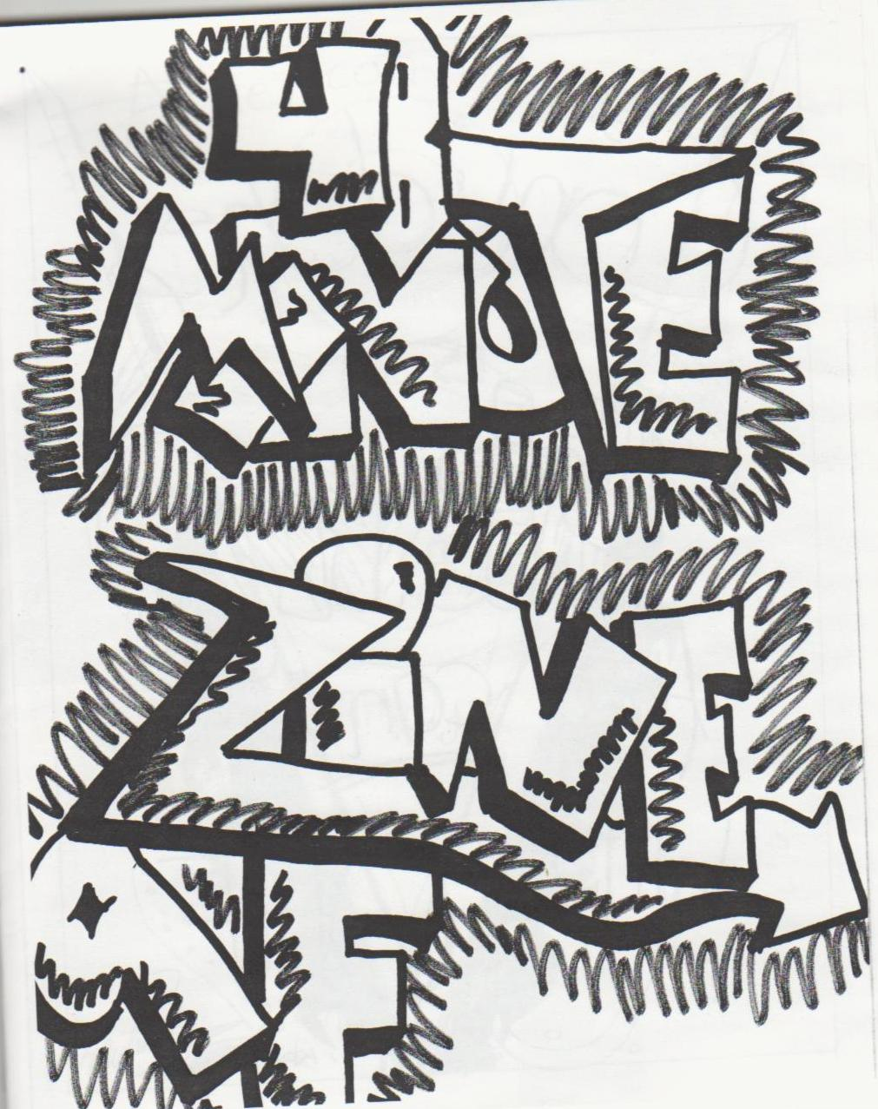

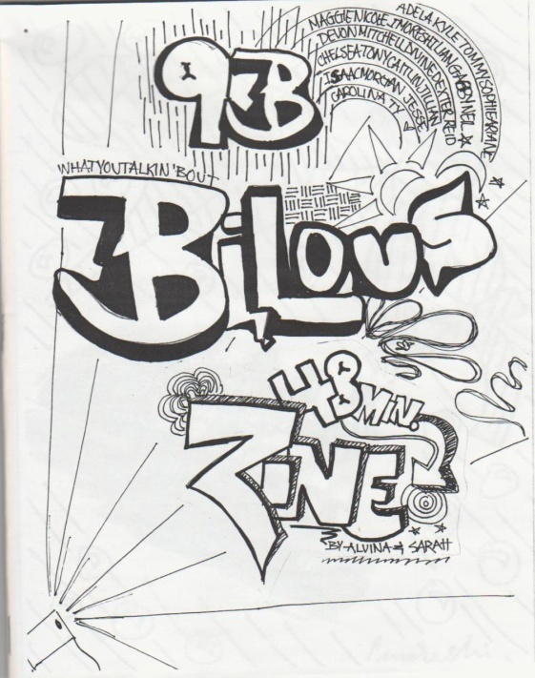
Give a time limit (one class period)
Choose a student to make the front cover
Number of pages should be divisible by 4
Let them have fun
Hand out the finished zine next class

Slide 11
Third class – Read the 48 minute zine
Each student gets a copy
Give 10-15 minutes to read it
Go over each page, highlighting strengths
Only the author of a page can criticize his/her page
Make 2 lists: What Worked / What Didn’t

Slide 12
Fourth class – Invite students to zine fest
Hand out participants’ packages
Establish expectations, timeline, etc.
Students brainstorm ideas
Students begin planning their zines & creating personalized timelines

Slide 13
Zine Fest Participant’s Package
Zine Fest invitation business letter
List of required genres (adaptable)
List of optional/recommended genres
Requirement checklist/timeline
Calendar with important dates
Marking rubric for the zine

Slide 14
Fifth class and beyond
Zine classes work best as workshops
Students work individually according to their own timelines
Minilessons throughout
Business letter reply (due before PAT)
One-to-one conferences

Slide 15
Minilessons (5-10 min.)
Theme choice
Specific genres
Cost of zine production (colour vs. black & white)
Design & layout
Problem areas for small groups & individuals

Slide 16

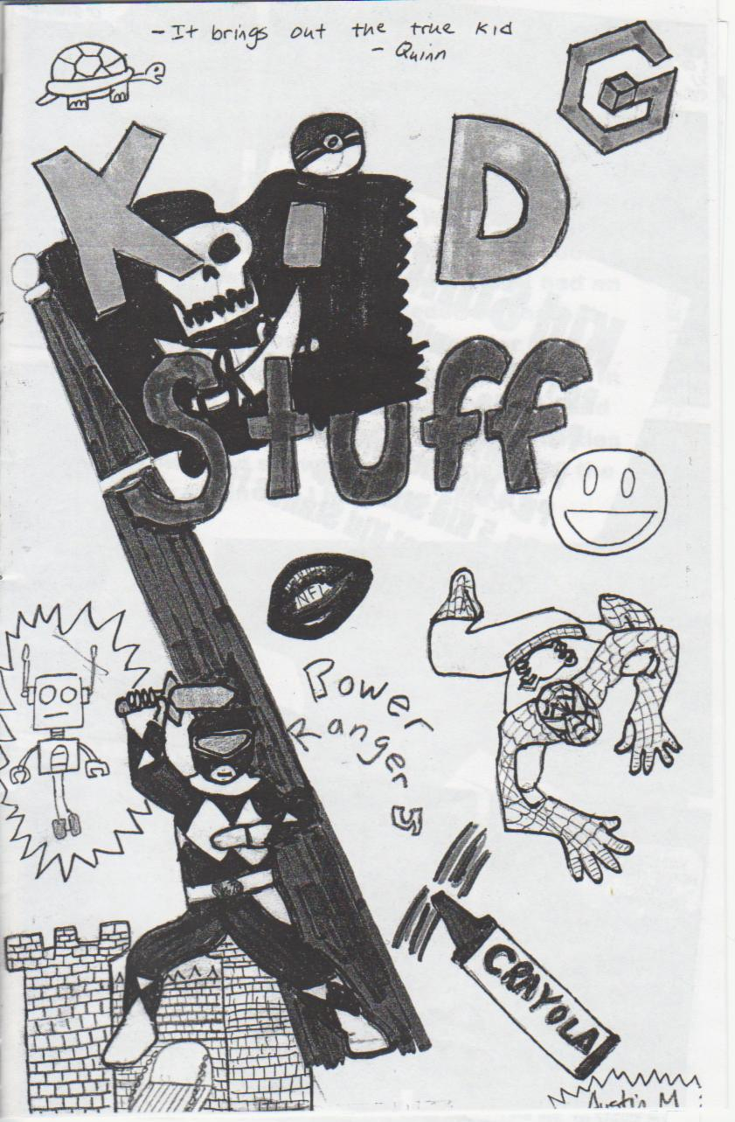
Zine Fest!
At least one full class
Students hand in their zines
Students read from their zines
Students trade their zines
Students read each other’s zines
Celebrate all their hard work

Slide 17
NOW… The 20 minute zine!
THEME: TEACHING LANGUAGE ARTS
Groups of four
Each member gets a quarter-folded paper
Each member contributes 2 pages to each zine
P. 1 is the front cover, P. 8 is the back cover
Use pens & paper. Draw, write, quote, whatever
Switch every 5 minutes
Cut, staple, and you’re done!

Slide 18
Other ways to publish with your students
Student literary magazine
Student-run publishing companies
Student anthologies
Poetry performance, like Poetry Slam
Suggestions?
Questions?

